Slide 1
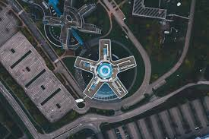
Intel Image Classification Using Xception model, Transfer Learning and Fine Tuning
Nitin Kumar

Slide 2
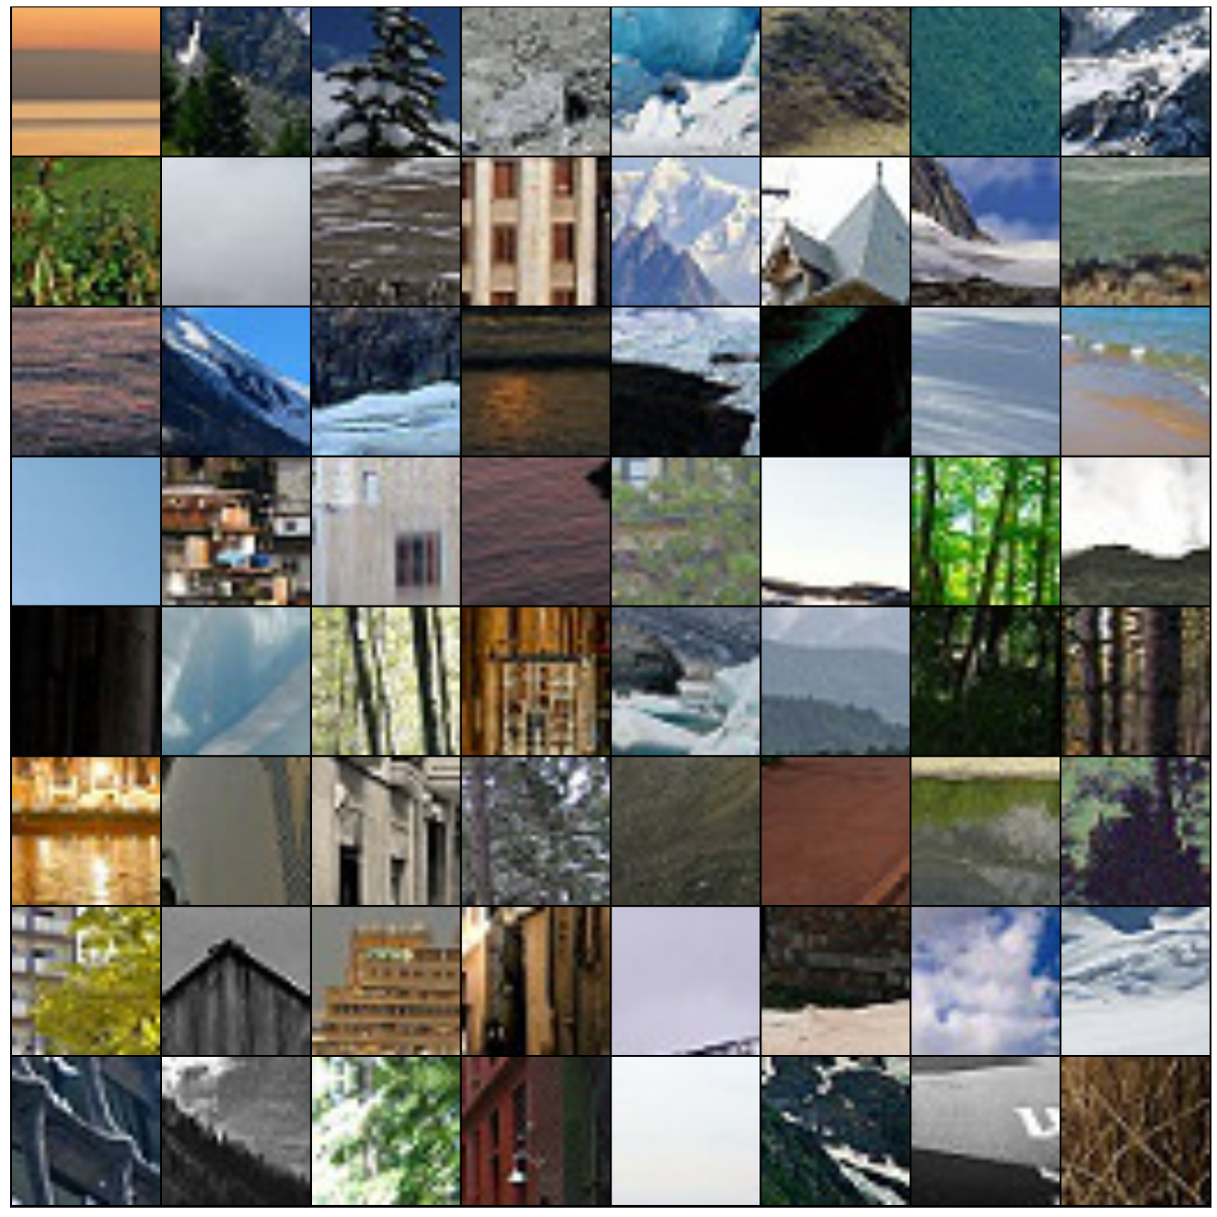
Problem Statement
The aim here is to create an image classification model to classify images into 6 classes Building, Sea, Mountain, Glacier, Street and Forest.
There are 13594 images for training and 3000 images are validation.
The images are of dimension 150 X 150 X 3
https://www.kaggle.com/puneet6060/intel-image-classification

Slide 3
Approach
For this Categorical problem statement, I am going to use Xceotuib model using imagenet weights.
Image Augmentation will be applied to training images.
To achieve low validation-loss and high categorical_accuracy a two-step training program will be implemented.
I am going to use TensorFlow - Keras API for model training.
For this project, I am going to use Google Collab environment.

Slide 4
Xception - Model
Xception has the same number of parameters as InceptionV3, but the increase in performance is not due to smart efficient use of the model parameters.
Xception Original paper by François Chollet
https://arxiv.org/abs/1610.02357
The model itself is made up of symmetric and asymmetric building blocks, including convolutions, average pooling, max pooling, concats, dropouts, and fully connected layers. Batchnorm is used extensively throughout the model and applied to activation inputs. Loss is computed via Softmax.

Slide 5
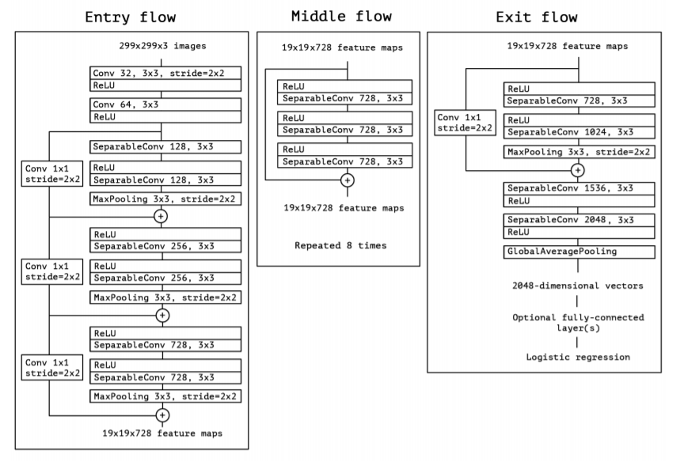
Xception Architecture

Slide 6
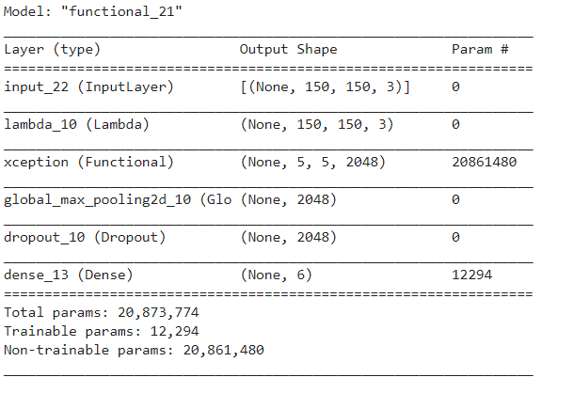
Customized Functional Model

Slide 7
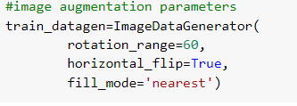
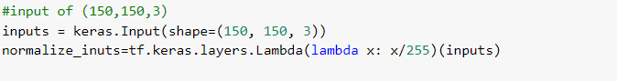
Image Processing and Augmentation
For training images, various image augmentation techniques are used to generate new images.
Train, Validation and Test images are loaded using Image Data Generator.
Images are scaled during model training using keras.layers.Lambda function.

Slide 8
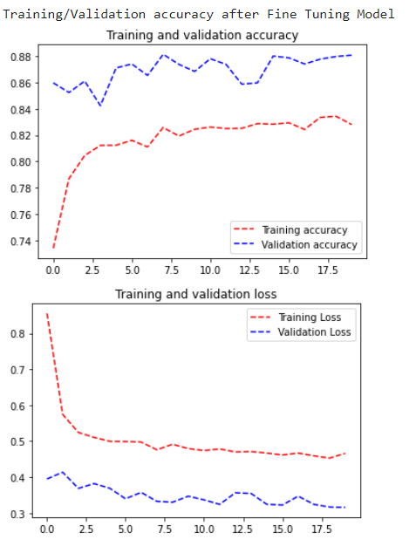
Model Compilation, Training and Result - 1
For model compilation, we are going to use categorical cross-entropy as loss, Adam optimizer and Categorical Accuracy as metrics.
Learning rate is set to default.
Early stopping call back is used to monitor val_loss with the patience of 10.
The model is trained for 20 epochs with batch size as 32.
Here we can observe that training accuracy & loss is less than validation, this is because of augmentation applied to the training images.

Slide 9
Model Compilation, Training and Result - 2
For model compilation, we are going to use categorical cross-entropy as loss, Adam optimizer and Categorical Accuracy as metrics.
For this step, we are going to reduce the learning_rate to ‘le-5’.
Early stopping call back is used to monitor val_loss with the patience of 5.
Custom callback is used to stop training if binary_val_accuracy > 0.98.
The model is trained for 20 epochs with batch size as 32.
Model training stop after epochs.
Final Model Results:
Training_loss: 0.1082
Training_accuracy: 0.9599
Val_loss: 0.1994
Val_accuracy: 0.9287

Slide 10
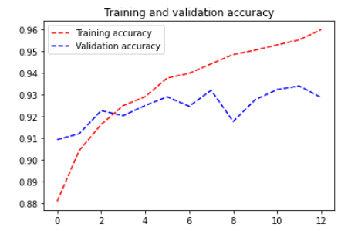
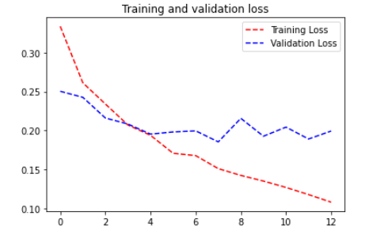
Training Graph

Slide 11
Sources
https://cloud.google.com/tpu/docs/inception-v3-advanced
https://arxiv.org/pdf/1610.02357.pdf
https://keras.io/api/applications/xception/

